Slide 1
Machine Learning
M.Hamza Rizwan
2023-BS-AI-005
Presented to Mr. Saeed

Slide 2
Project Introduction
Power Consumption Prediction Using Machine Learning is a Linear Regression project that have the following objectives :
To build a predictive model that forecasts power consumption based on historical energy usage and related variables.
To support energy management and planning by anticipating demand patterns.

Slide 3
Dataset Description
Source: Custom dataset (power_consumption.csv) Features : The dataset contains over 2 million records, each representing a single minute of data. For every minute, the following information is recorded:
Date and Time: A timestamp showing exactly when the observation was made.
Global Active Power: The total amount of active power used in the household, measured in kilowatts (kW).
Voltage: The supply voltage at that moment, measured in volts (V).
Global Intensity: The total current drawn by the household, measured in amperes (A).
Sub-metering 1, 2, and 3: These show how much energy was used in three different areas or appliances in the house, measured separately.

Slide 4
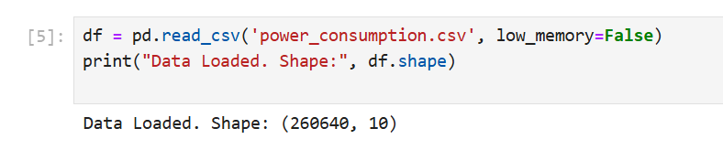
Dataset Description
The following is the way read the dataset in a jupyter notebook. It is the initial step in training any model.

Slide 5
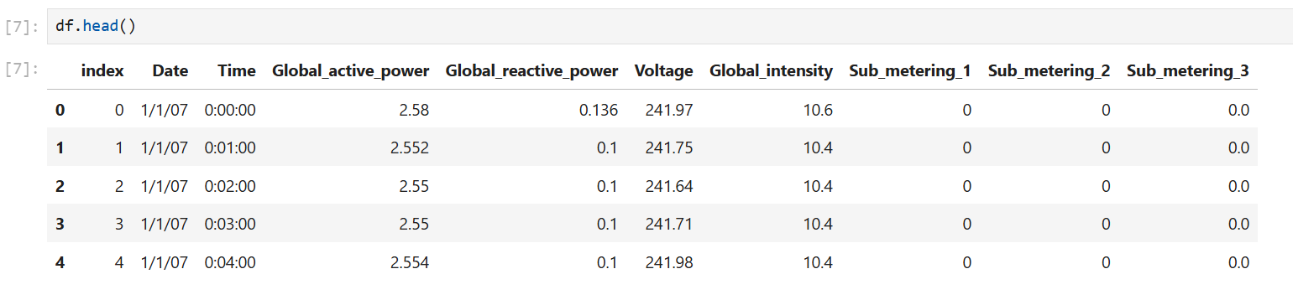
Dataset Description
The function df.head used to display all columns and first fewer rows.

Slide 6
Preprocessing Steps
Datetime Merging: The 'Date' and 'Time' columns were combined into a single datetime column.
Missing Value Handling: Rows containing missing values were removed.
Data Type Conversion: Power-related values were converted to float type.
Resampling: Data was aggregated by hour to reduce noise and computational load.
Feature Engineering: Temporal features such as hour, day of the week, and month were extracted.

Slide 7
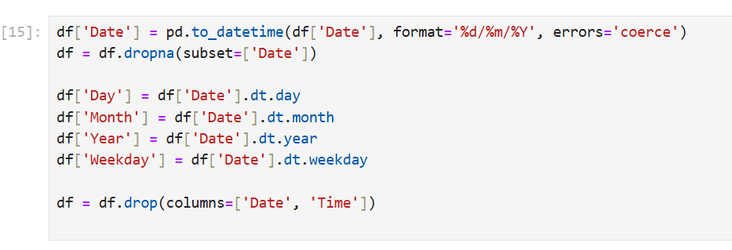
Preprocessing Steps
The following functions are used to combine the date and time into a single column.

Slide 8
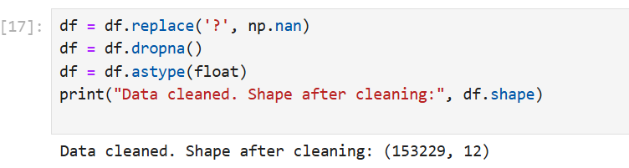
Preprocessing Steps
The following functions in the preprocessing steps are used to clean the data, remove extra values and converting the datatypes to what is suitable

Slide 9
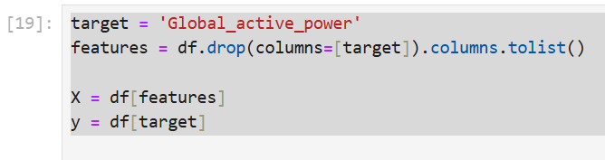
Preprocessing Steps
After cleaning and transforming the data, the target variable 'Global_active_power' was defined, and all other relevant columns were selected as input features

Slide 10
Modeling
Train/Test Split: The dataset was split into training and testing sets using an 80/20 temporal split to preserve the time-series structure.
Models Used: Linear Regression was used as a baseline model. A Random Forest Regressor was applied as an ensemble method to improve accuracy. XGBoost was also used for optimized performance through gradient boosting.
Target Variable: The target variable for prediction was 'Global_active_power'

Slide 11
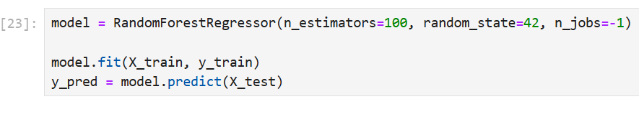
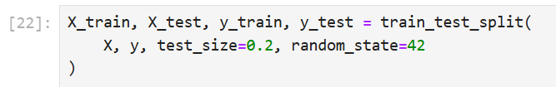
Modeling
A Random Forest Regressor with 100 trees was trained on the training data. The trained model was then used to predict 'Global_active_power' on the test set.
The dataset was split into training and testing sets, with 80% used for training and 20% for testing, ensuring reproducibility with a fixed random seed.

Slide 12
Evaluation
Metrics Used: Model performance was evaluated using Mean Absolute Error (MAE), Root Mean Squared Error (RMSE), and R² Score.
Performance Summary: Linear Regression showed moderate accuracy but struggled with non-linear patterns. Random Forest improved the results. XGBoost achieved the best performance with an R² of approximately 0.92 and low error metrics.

Slide 13
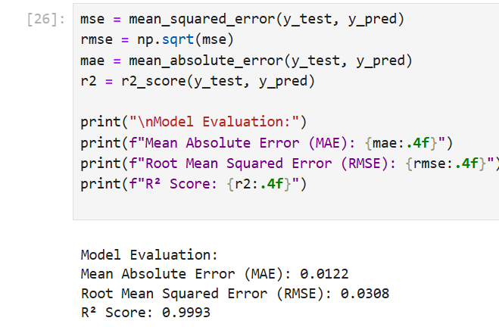
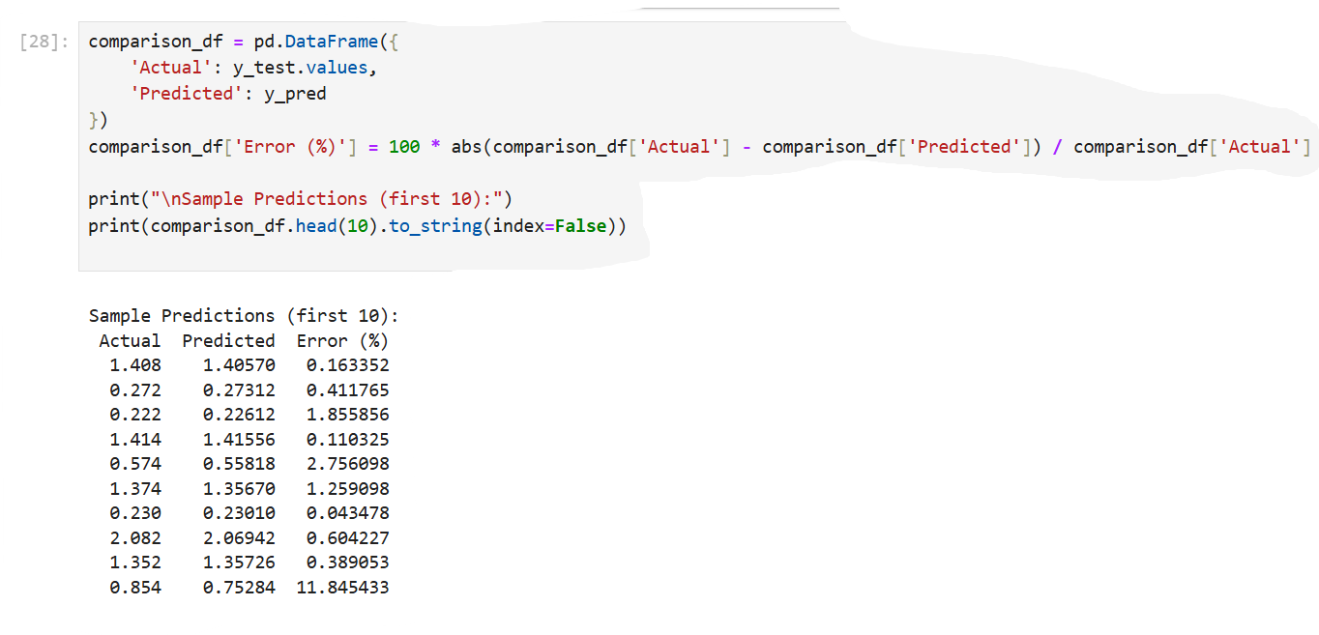
Evaluation
These are the functions and metrics evaluation outputs
This is the comparison of what was predicted and what is the actual answer

Slide 14
Key Findings
Impact of Temporal Patterns: Power usage was strongly influenced by temporal features such as the hour of the day and day of the week.
Model Performance: XGBoost outperformed other models, demonstrating strong generalization and predictive accuracy.
Sub-metering Influence: Sub-metering variables had limited impact on predicting global active power.
Effect of Aggregation: Aggregating data to an hourly level enhanced model stability and overall performance.

Slide 15
Conclusion
Predictive modeling has proven effective in estimating household power consumption, particularly when temporal patterns are taken into account. Proper preprocessing, including handling missing values and extracting features like hour and day of the week, is crucial for building accurate models. Ensemble models such as XGBoost are especially well-suited for time-series prediction tasks, as they can capture complex relationships and generalize well. For future improvement, incorporating additional data such as weather conditions and occupancy information could further enhance prediction accuracy.

